Slide 1
Are we turning a corner on BGP security?
Nina Bargisen, nina@kentik.com, Kentik

Slide 2
Where are we with RPKI ROV adoption?
Presently stands as the Internet’s best defense against BGP hijacks due to typos or other BGP mishaps.
Core challenge: broad deployment requires many individual actions.
Why reject RPKI-invalids if no one is creating ROAs?
Why create ROAs if no one is rejecting RPKI-invalids?

Slide 3
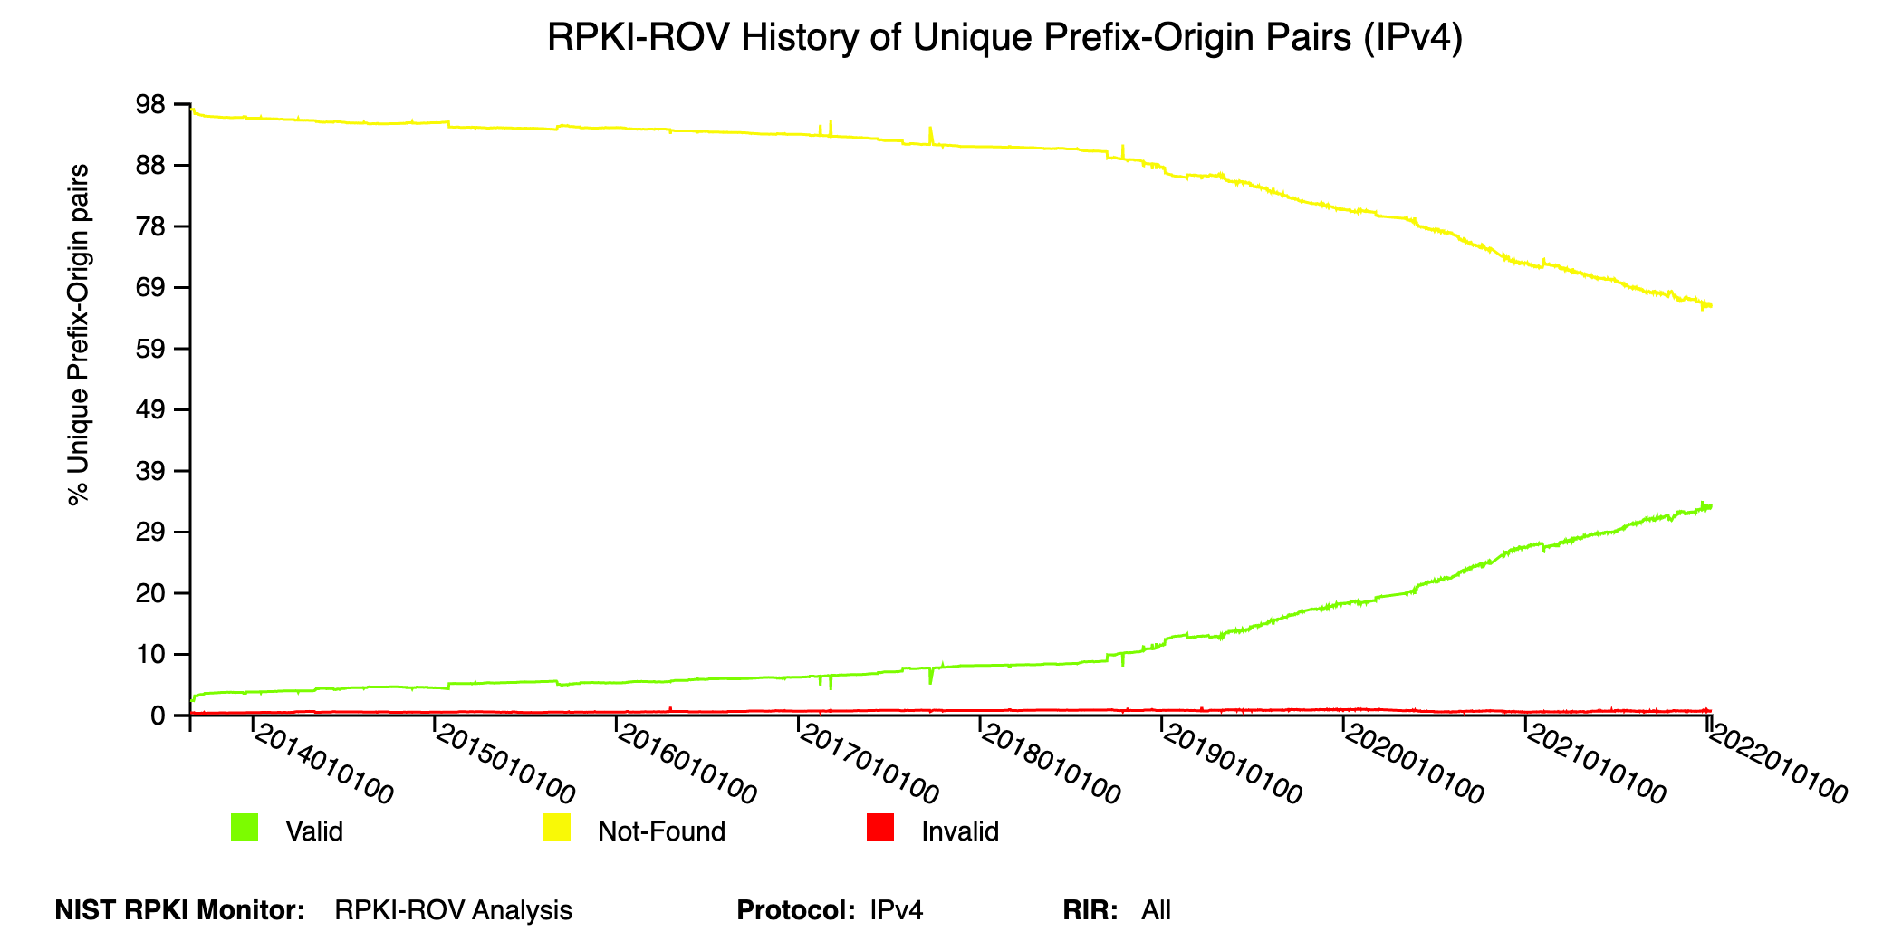
Where are we with RPKI ROV adoption?
Enormous progress in recent years as Tier-1 NSPs agreed to reject RPKI-Invalids.
NTT, GTT, Arelion (Telia), Cogent, Telstra, PCCW, Lumen, and more!
According to NIST RPKI Monitor, the trend line is going in the right direction!
Unknown going ↓
Valid going ↑
https://rpki-monitor.antd.nist.gov

Slide 4
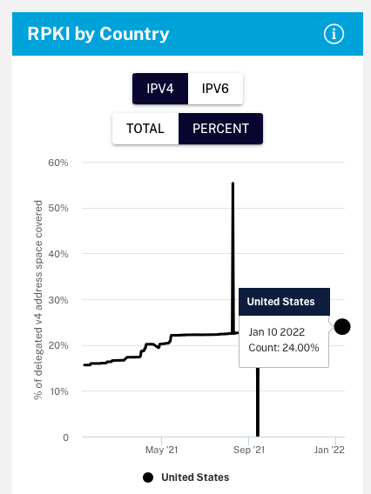
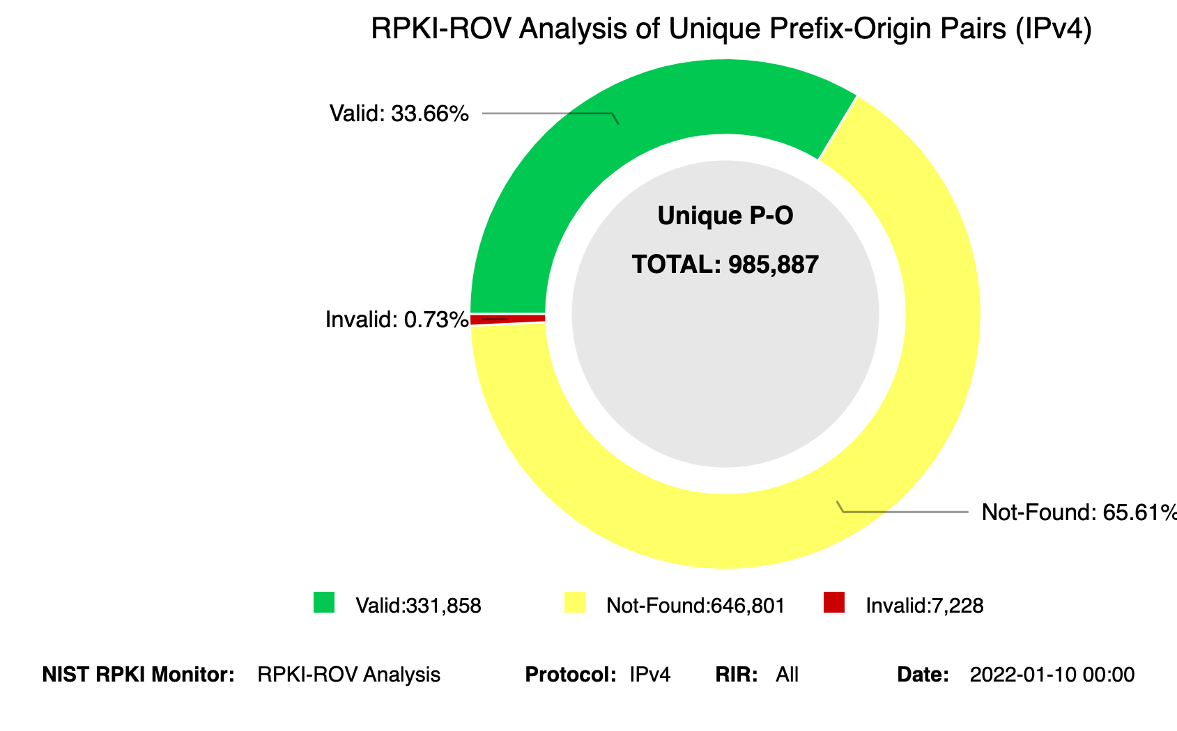
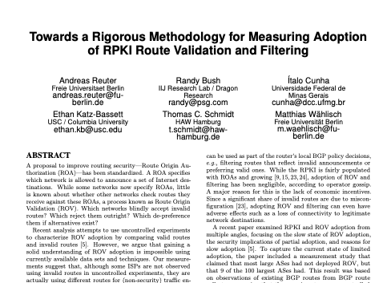
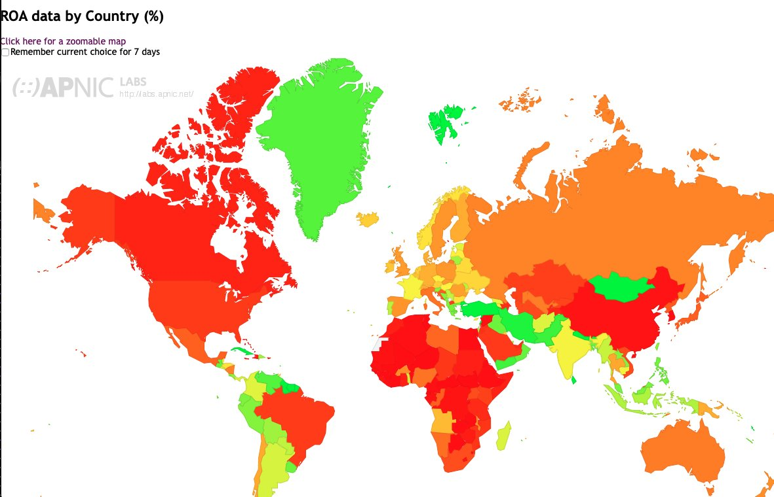
Measuring RPKI deployment progress
It takes two steps to reject an RPKI-Invalid BGP route.
1
ROAs created to assert valid origin and prefix length.
2
Networks reject RPKI-invalids
How to evaluate progress?
Multiple resources (ex: NIST, RIPE)
Active area of research
https://stats.labs.apnic.net/roas

Slide 5
Measuring RPKI deployment progress
We have two questions we want to answer.
1
ROAs created to assert valid origin and prefix length.
2
Networks reject RPKI-invalids
How to evaluate progress?
Multiple resources (ex: NIST, RIPE)
Active area of research
How much traffic goes to routes with valid ROAs?
How much does RPKI ROV reduce the propagation of invalid routes?
https://stats.labs.apnic.net/roas

Slide 6
Where are we with ROA creation?
NIST RPKI Monitor reports that only 34.1% of IPv4 BGP routes are presently signed. *
Two RPKI unknown routes for each RPKI valid one.
Question:
What proportion of overall traffic is safeguarded by that 34.1%?
*32.6% of IPv6 routes are RPKI-Valid
Notes:
Todays number is 39.9%

Slide 7
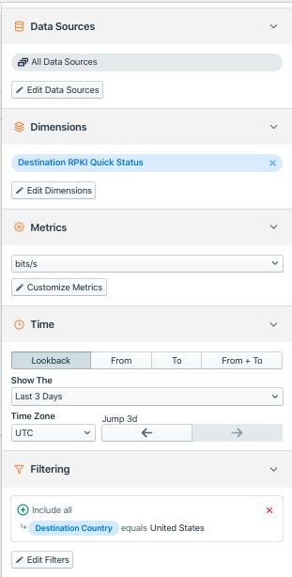
Kentik’s perspective can deepen understanding of RPKI
Kentik has over 300 customers and almost half have opted-in to the use of their data as part of aggregate analysis.
Note: analysis is subject to biases of the customer set which includes (NSPs, CDNs and enterprises) and is skewed toward the US.
Kentik’s NetFlow analytics platform annotates flow records with an RPKI evaluation of route of destination IP upon intake.
Originally built to understand how much traffic would be lost by dropping invalids.
Can also be used to understand RPKI from a traffic-volume perspective.

Slide 8
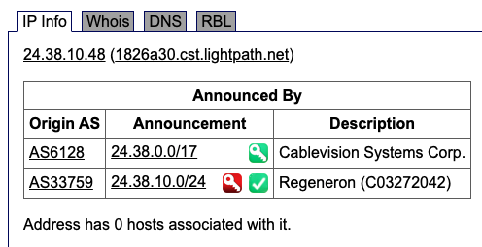
What proportion of traffic goes to signed routes?
Kentik tracks four cases of RPKI outcome.
Valid
Unknown
Invalid
Invalid – but covered by valid/unknown
Note #4 only exists in the analysis-plane and is not part of IETF/BGP/Routing!
Example of #4:

Slide 9
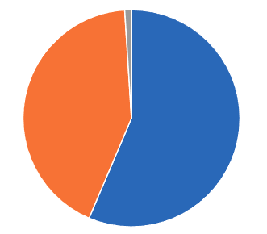
Only ~1/3 of BGP routes have ROAs - but how much traffic?
Period of analysis: 22 Arp 2022 00:00 UTC to 29 Apr 2022 00:00 UTC (7 days)
Main Observations*
0.1% of traffic volume is ‘Invalid but covering’
41.0% is Unknown
58.0% is Valid
0. 1% is Invalid
Traffic to invalid routes is infinitesimal.
Not a reason to not drop invalids.
Invalid but covering
0.99%
Unknown
42.6%
Valid
56.4%
*Combined IPv4 + IPv6
Notes:
Current global number 39.9% have ROAs
1299 kindly informed us that they saw 0.35% of traffic going to invalids in 2019 before they decided to drop

Slide 10
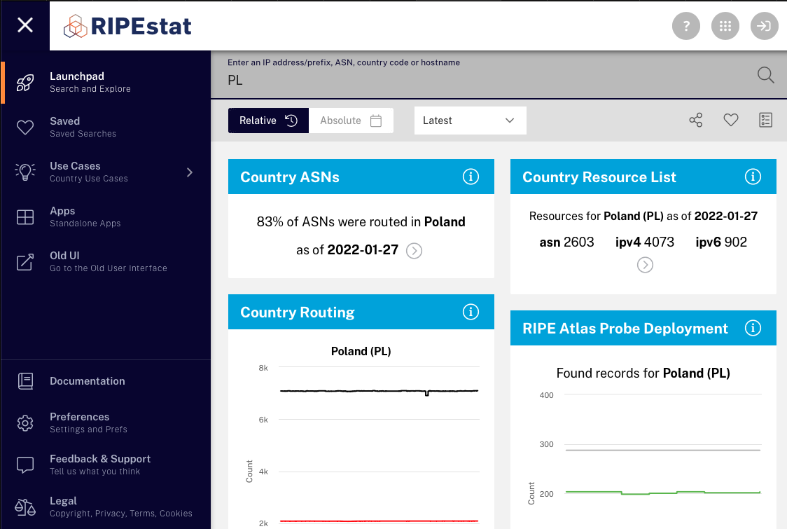
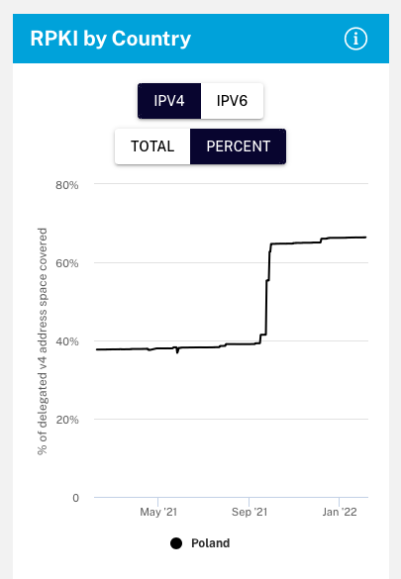
Comparing metrics for ROA creation by country
RIPEstat reports % of IP address space
https://stat.ripe.net/app/launchpad/

Slide 11
For example, how is the US doing with ROA creation?
United States
Major RPKI deployments Valid %*
Eyeball networks
Comcast (AS7922) 99.7%
Spectrum (AS20115) 99.9%
Content providers
Amazon (AS16509) 100%
Google (AS15169) 100%
Cloudflare (AS13335) 93.3%
Maybe not a majority of BGP routes, but these companies account for a lot of US traffic!
Why?
60.4% of bits/sec (NetFlow)*
24.2% of IPv4 space (RIPEstat)
20.1% of IPv6 space
*Combined IPv4 + IPv6
Notes:
24.2% of the delegated ipv4 space is signed – 20.1% of the v6 space

Slide 12
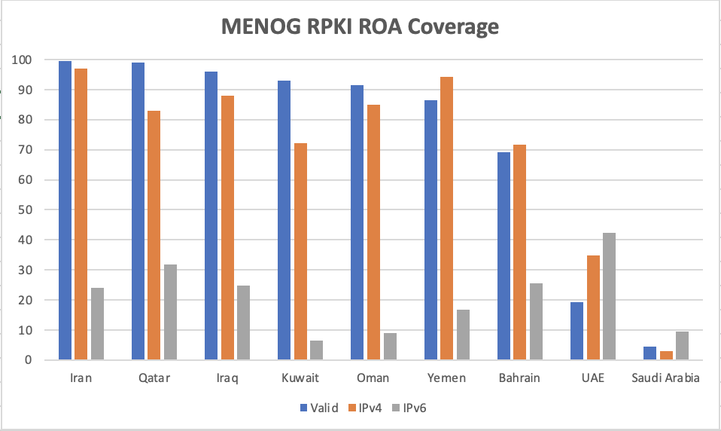
How about the Middle East?
Almost all traffic to desti- nations in most countries is going to valid prefixes
In general a very high amount of IPv4 address space covered by ROAs
What’s going on with IPv6?
GOOD JOB!

Slide 13
Question: | How much traffic goes to routes with valid ROAs?
Answer: | Most of it!
Question: | How much does RPKI reduce propagation of invalids?
Answer: | Let’s find out…

Slide 14
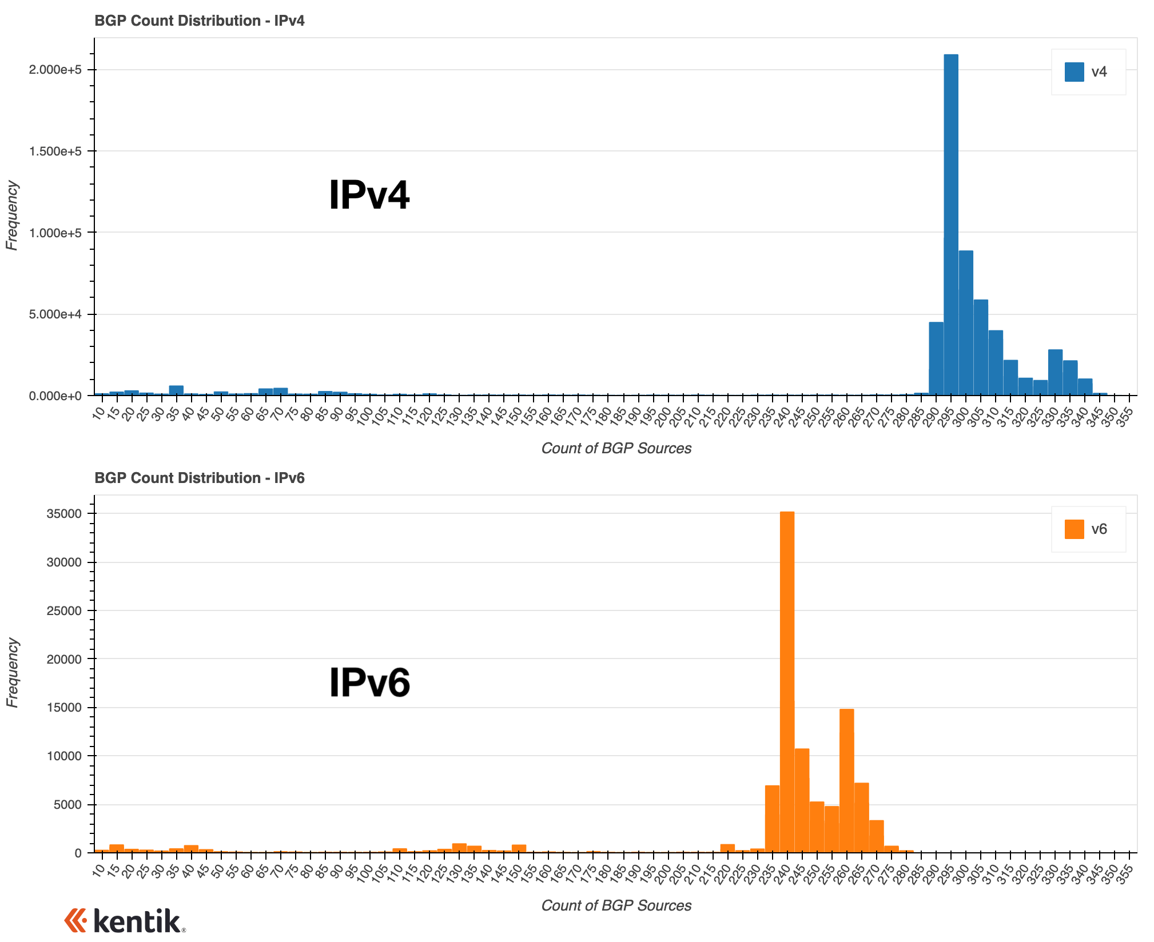
RPKI ROV & propagation of invalids
On the right is a histogram of the number of IPv4 and IPv6 prefixes seen by count of vantage points.
The count of vantage points can serve as a measure of route’s propagation — the more vantage points, the more propagation.
Peaks of globally routed prefixes (those seen by nearly all vantage points)
295 for IPv4
240 for IPv6*
* the lower number reflects the smaller number of IPv6 vantage points in the Routeviews dataset.

Slide 15
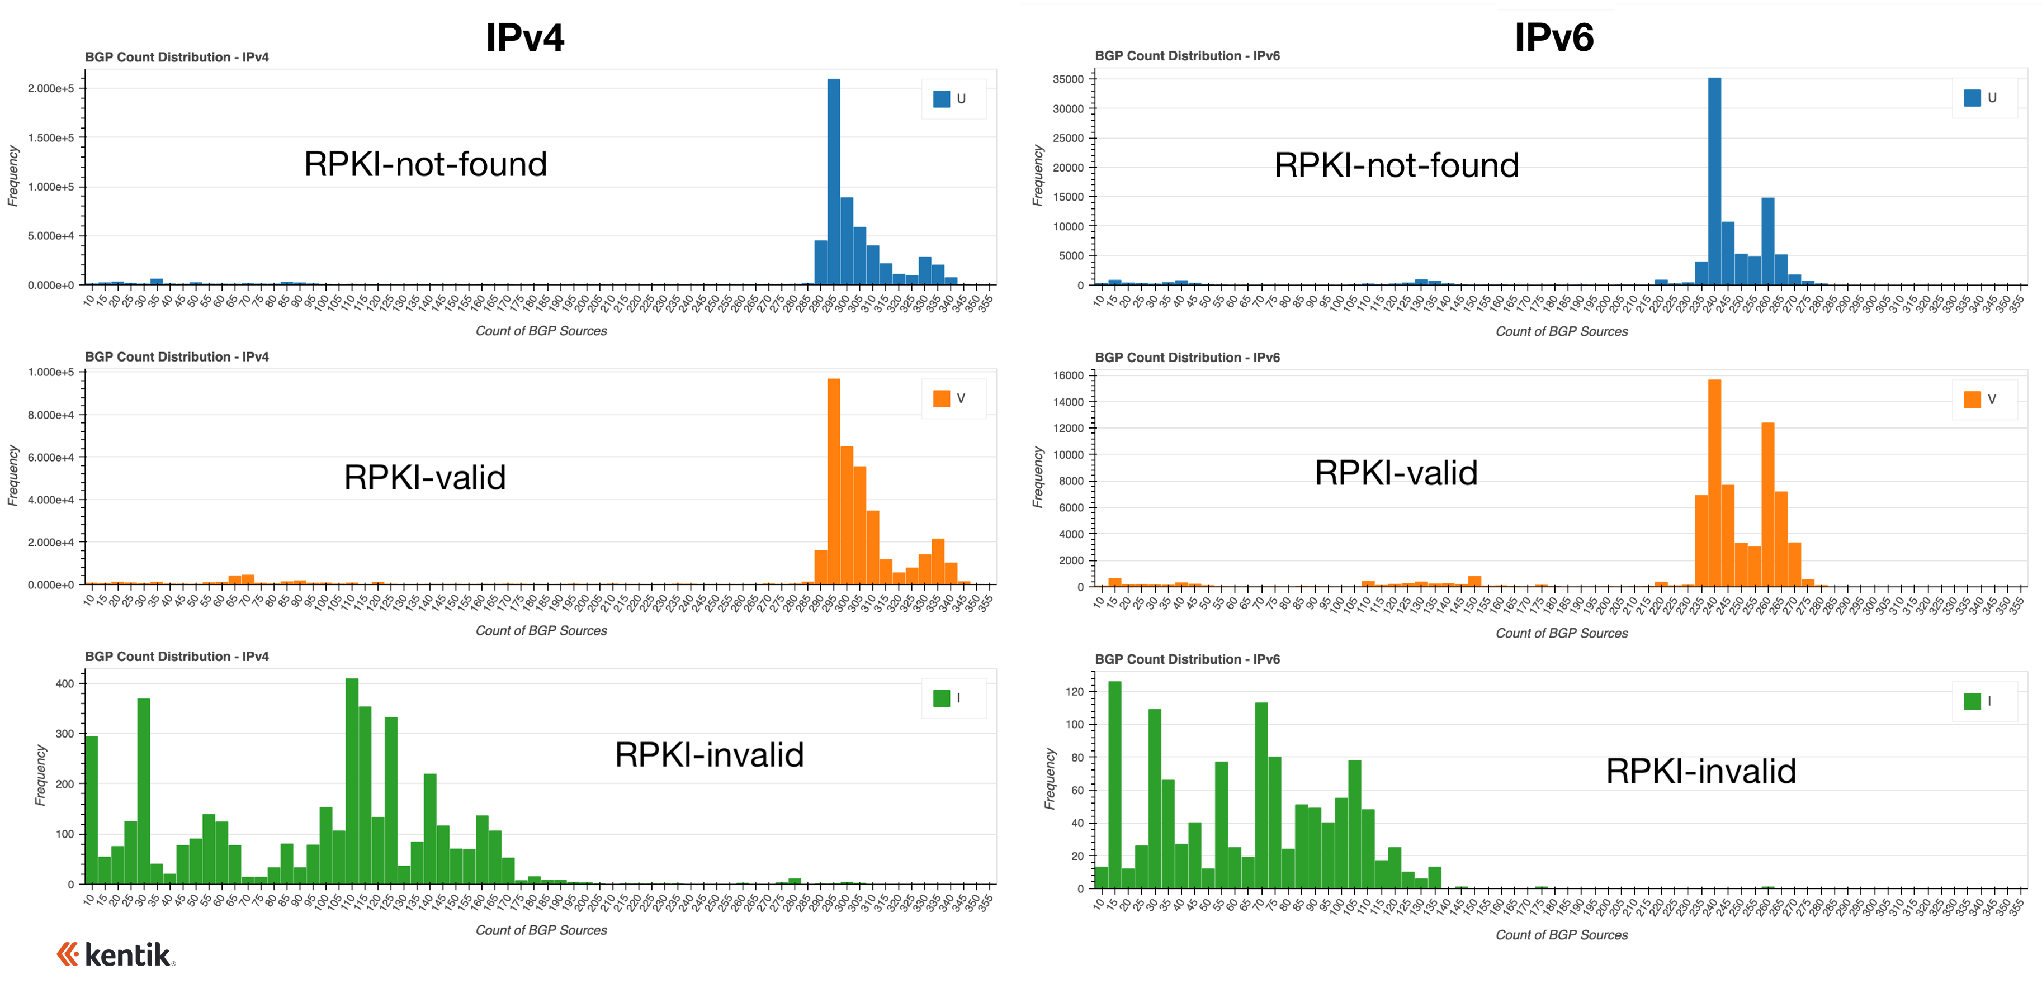
RPKI=invalid routes propagate far less than other types.

Slide 16
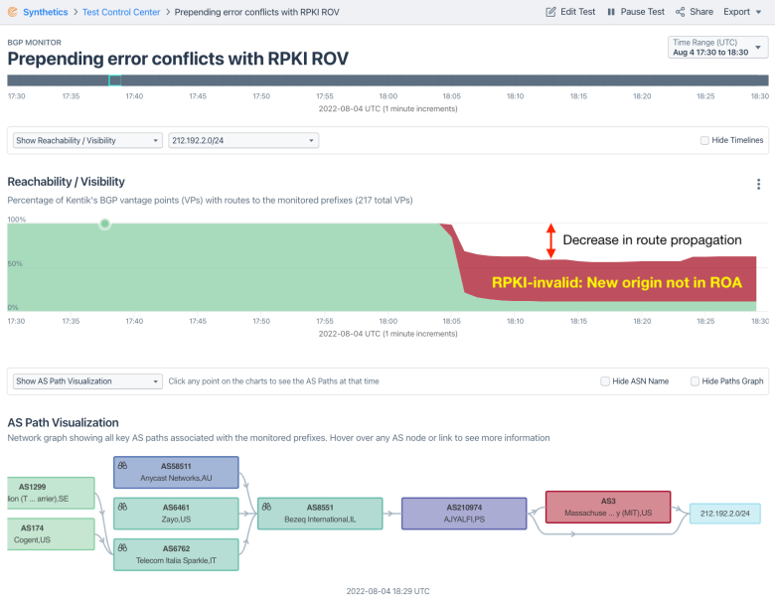
Example routes which change state from valid to invalid
These errors occur when a network engineer attempts to prepend an AS three times, for example, but instead ends up prepending the number 3 to the AS path.
AS210974 changed how it announced 212.192.2.0/24 on August 4, 2022.
It began prepending the number 3 to its AS path, however since there was a ROA for this prefix, it also caused the route to become invalid leading to a significant drop in propagation.

Slide 17
In Summary
Question: | How much traffic goes to routes with valid ROAs?
Answer: | Most of it!
Question: | How much does RPKI reduce propagation of invalids?
Answer: | Evaluation of a route as RPKI-invalid reduces its propagation by 1/2 to 2/3.

Slide 18
Best Current Practice – Reject RPKI-Invalid BGP routes!
Rejecting RPKI-Invalid routes on EBGP sessions…
Protects a majority of your outbound traffic from BGP hijacks due to typos, BGP mishaps.
Not a risk to legitimate traffic.
Other BCPs include:
Do NOT modify LOCAL_PREF based on validation states
Do NOT set / remove BGP communities based on validation states
Security issues like CVE-2021-41531 / CVE-2021-3761 are examples of how not following the above BCP could result in massive BGP churn!
https://bgpfilterguide.nlnog.net/guides/reject_invalids/

